Slide 1
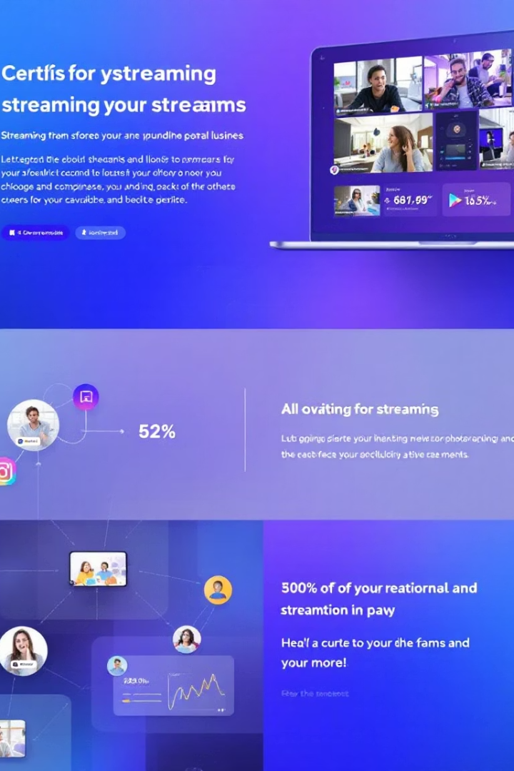

Streaming Service User Analysis
An in-depth examination of user behavior and engagement patterns within a popular streaming platform, revealing key insights for business stakeholders and data analysts.
by Rohit Prakash

Slide 2

Project Overview
This analysis examines user behavior on a streaming platform using Microsoft Excel. We'll uncover patterns in viewing habits, subscription preferences, and engagement metrics.
Our findings will help optimize content recommendations and inform strategic business decisions.

Slide 3





Dataset Composition
User Details
User ID, Username, Join Date, Last Login, Country Name, Age Group
Content Interaction
Watch Hours, Favorite Genre, Movies Watched, Series Watched, Ratings
Financial Data
Monthly Price, Payment Method, Membership Status, Loyalty Points
Technical Usage
Active Devices, Profile Count, First Device Used, Downloaded Content

Slide 4

Methodological Approach
Insight Generation
Data Examination
Extracted actionable business intelligence from the processed data.
Excel Formula Application
Conducted thorough analysis to identify patterns and relationships between variables.
Data Acquisition
Downloaded the complete dataset containing 1,000 user records with 23 variables.
Applied specialized Excel functions to process and transform raw data.

Slide 5





Data Preparation Process
Data Security
Encrypted dataset and saved securely on desktop.
Formatting
Applied consistent formatting with grid lines and appropriate alignment.
Quality Control
Verified all 1,000 rows and 23 columns for completeness.
Visual Enhancement
Added header styling with bold formatting and color coding.

Slide 6

Technical Resources
Microsoft Excel 365
Microsoft PowerPoint
Primary tool for exploratory data analysis, formula application, and visualization creation.
Used for creating the final project presentation with visual elements.
Google Chrome
Research platform for supplementary information and comparative insights.

Slide 7






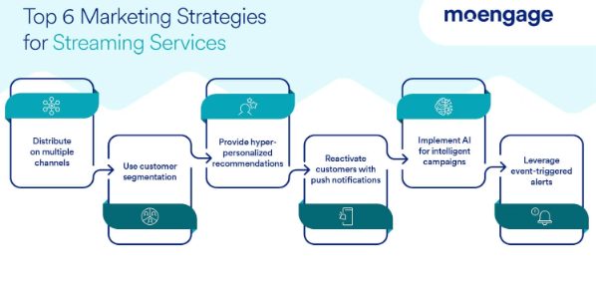
Project Objectives
Optimize User Experience
Enhance content discovery and platform navigation
Identify Usage Patterns
Track viewing habits and interaction metrics
Generate Business Insights
Inform strategic decisions and marketing approaches

Slide 8
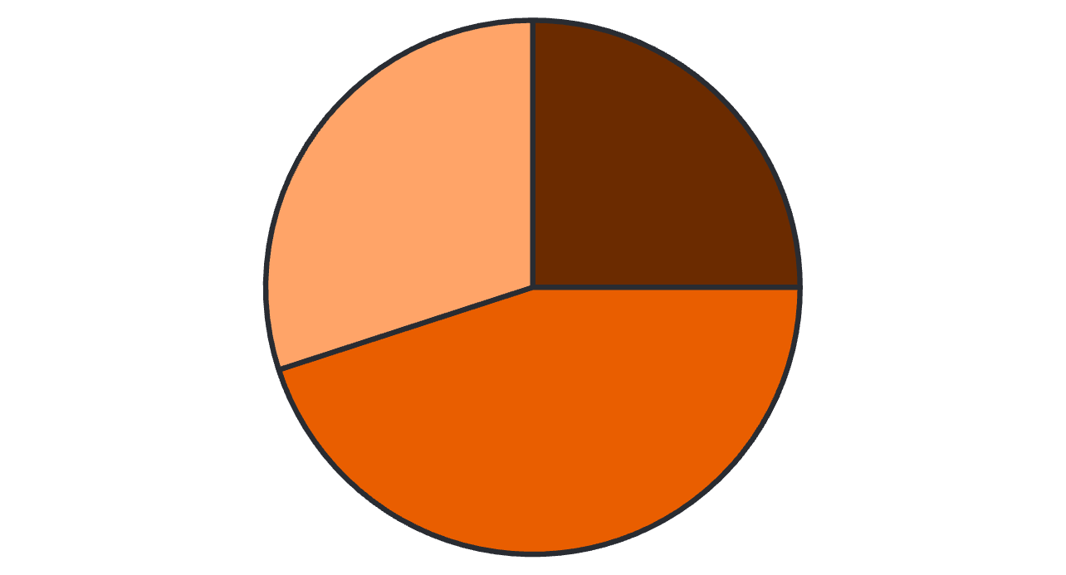
Revenue Analysis
Basic ($7.99)
Standard ($11.99)
Premium ($15.99)
Monthly revenue calculation: Active subscribers × Monthly fee = $12,026,000 total revenue. Standard tier generates the highest revenue share at 45%.

Slide 9
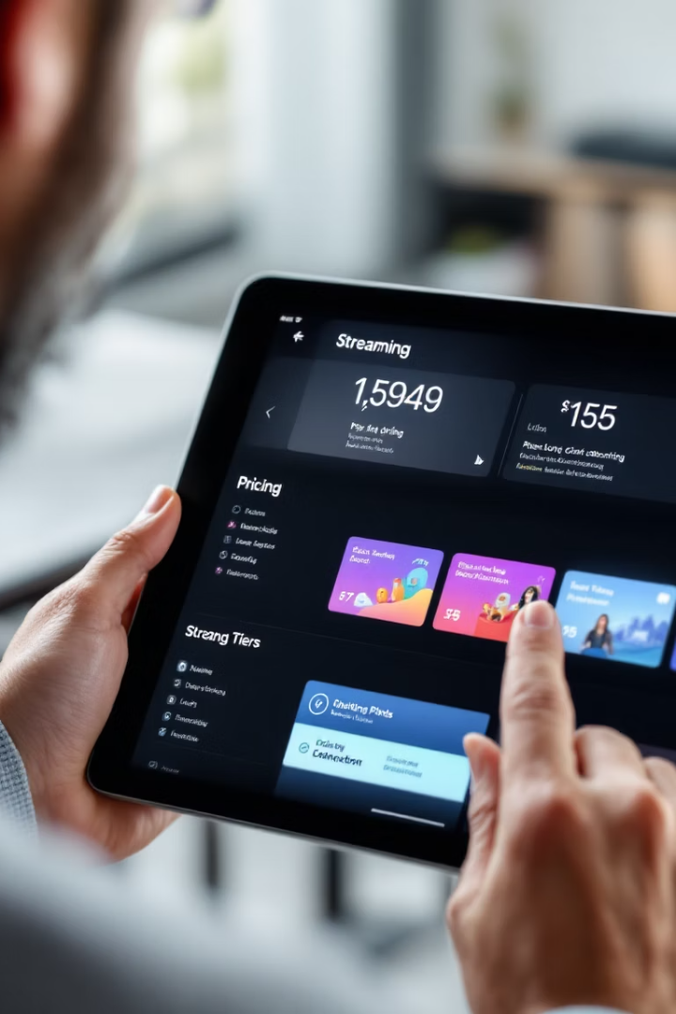
Pricing Tier Distribution
$7.99
$11.99
Basic Tier
Standard Tier
Drama leads with 59 preference points
Horror dominates with 56 preference points
$15.99
Premium Tier
Comedy tops with 54 preference points
The $11.99 tier shows the most balanced genre distribution. This indicates strong value perception across diverse audience segments.

Slide 10








User Engagement Metrics
Content Ratings
Watch Time
Indicates satisfaction and quality perception
Average 500 hours per user
Device Usage
Downloaded Content
Reveals platform access patterns
Shows offline viewing preferences

Slide 11
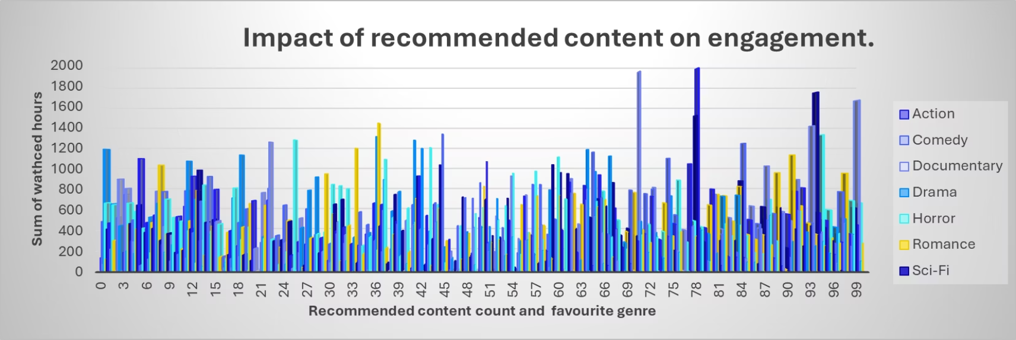
Content Consumption Patterns
Movies vs. Series
Content Discovery
Users watch significantly more movies than series. The data shows 11,859 total movies watched compared to 2,469 series.
Recommendations drive higher engagement rates. Sci-fi content generates the highest engagement at 1,980 hours per user.
This 5:1 ratio suggests users prefer shorter, complete experiences over episodic content.
Personalized recommendations align with user interests, increasing platform time and interaction.

Slide 12
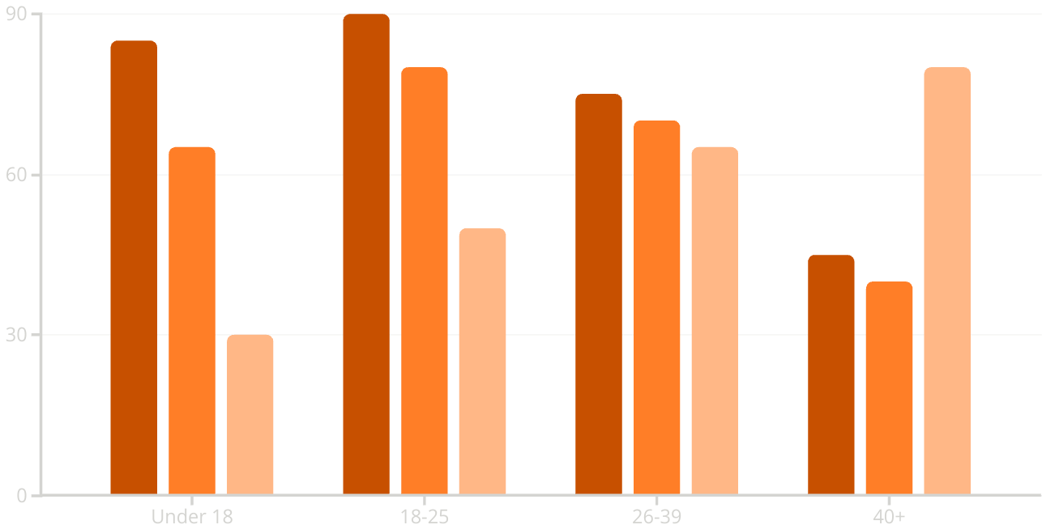
Demographic Genre Preferences
Comedy
Action
Drama
Comedy dominates preferences for viewers under 39. Older demographics shift toward drama. Children prefer animation and family content. Adolescents favor action and fantasy.

Slide 13

Device Usage Analysis
56,814
Smartphone Hours
Highest device usage
53,863
Smart TV Hours
Second most popular
52,456
Tablet Hours
Third place device
49,473
Desktop Hours
Fourth in usage ranking
Smartphones lead device usage with 56,814 watch hours. Smart TVs follow closely at 53,863 hours. Mobile viewing continues to dominate consumption patterns.

Slide 14
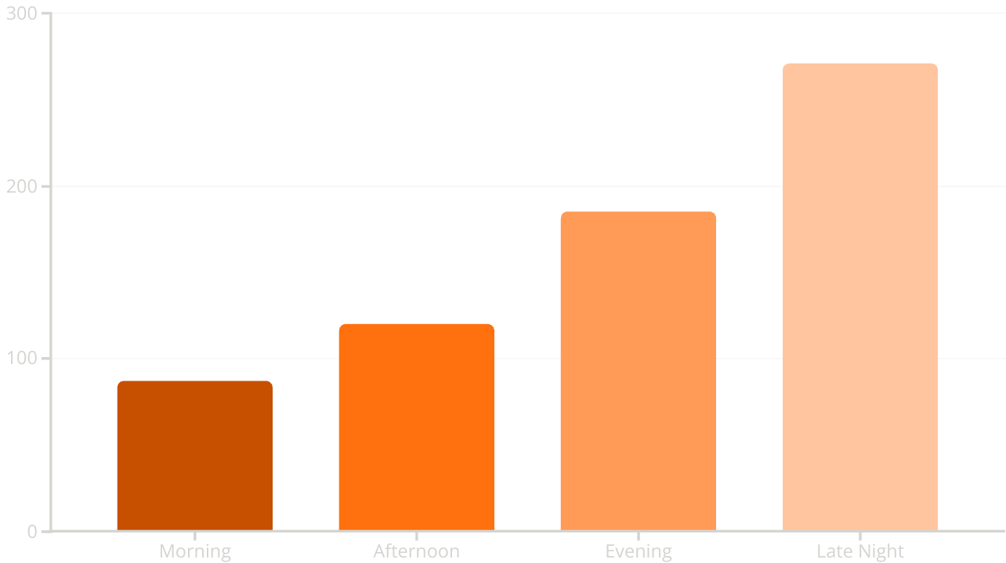
Peak Viewing Times
Late night viewing dominates with 271 hours. Evening follows with 185 hours. Streaming platforms enable time-shifted viewing compared to traditional TV schedules.

Slide 15








Membership Activity Status
Elite Members
500,000+ loyalty points
Premium Members
250,000-500,000 loyalty points
Standard Members
100,000-250,000 loyalty points
New Members
0-100,000 loyalty points
All users maintain active status. The dataset shows 2,444,217 loyalty points distributed among active members. No inactive users appear in the dataset.

Slide 16




Loyalty Points Distribution
Point Accumulation
Tier Progression
Users earn points through engagement and purchases
Point thresholds unlock higher membership tiers
Continued Engagement
Reward Redemption
Rewards drive further platform interaction
Points exchanged for discounts and premium content
The $7.99 monthly tier accumulates the most loyalty points at 826,831. This suggests the mid-tier pricing attracts highly engaged users.

Slide 17
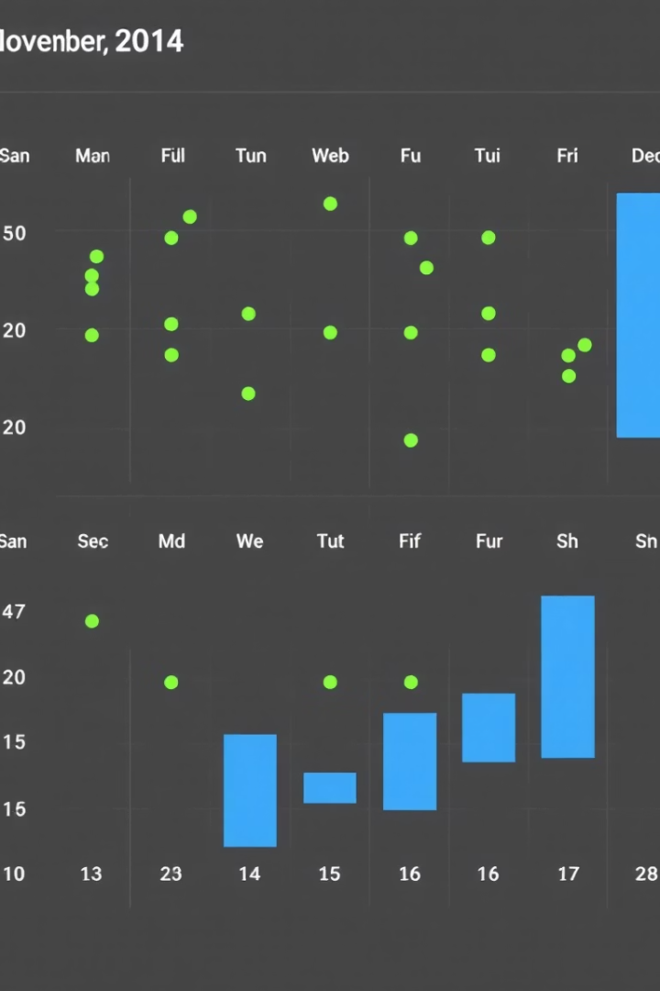



Login & Download Frequency
November
421 content downloads
Lower engagement month
December
579 content downloads
Peak activity month
Growth Trend
37.5% increase month-over-month
Significant engagement growth
December saw the highest login frequency with 579 content downloads. This represents a 37.5% increase over November's 421 downloads.

Slide 18
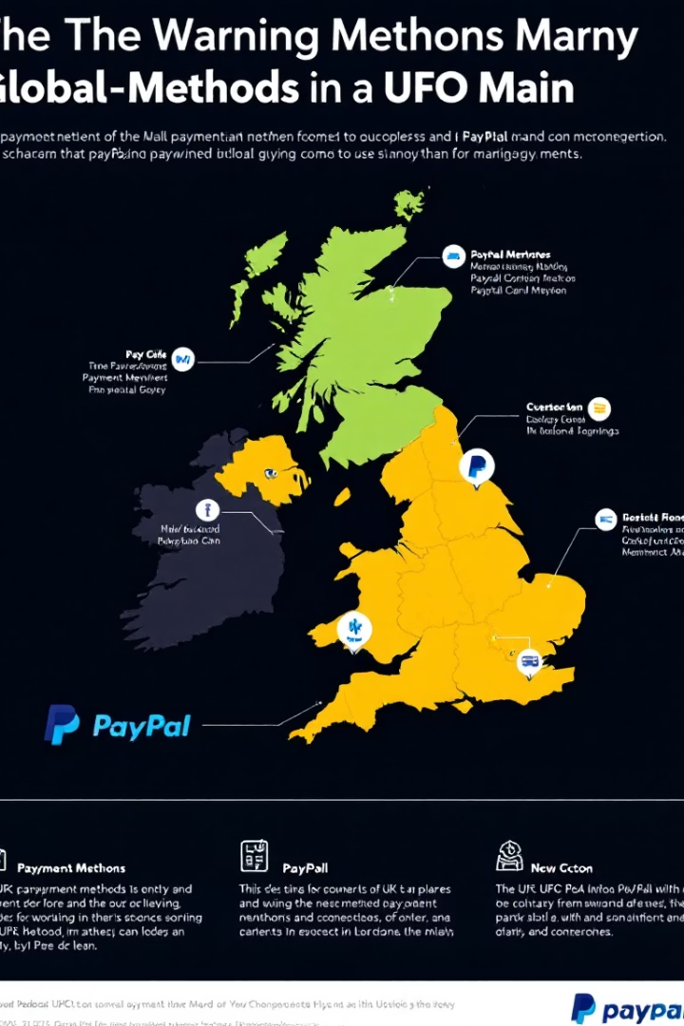
Payment Method Preferences
United Kingdom
Continental Europe
PayPal dominates with 48% market share
Bank transfers lead in Germany and Scandinavia
Digital wallet adoption exceeds global average
Digital wallets growing at 15% annually
Credit cards rank second at 32%
Mobile payments increasing among younger users
North America
Credit cards remain dominant at 65%
PayPal usage at 22% and growing
Apple/Google Pay adoption accelerating
PayPal leads UK payment preferences at 48%. Regional payment trends reflect technological infrastructure and consumer trust in payment systems.

Slide 19

Global Subscription Trends
United States
Leading market with 1,890.42 subscriptions in sample
Mature market with high subscription diversity
Western Europe
Second largest market at approximately 1,250 subscriptions
Growth driven by local content investment
Asia Pacific
Fastest growing region with 950+ subscriptions
Mobile-first viewing dominates consumption patterns
Emerging Markets
Showing 25%+ annual growth from lower base
Price sensitivity drives different subscription models
The US leads global subscription volume with 1,890.42 subscriptions. Market maturity correlates with higher subscription rates across entertainment platforms.

Slide 20

🗝️ Conclusions
Conducted in-depth analysis using Microsoft Excel to explore user behavior on a streaming platform.
Analyzed a rich dataset covering user demographics, activity metrics, content preferences, and device usage.
Identified key engagement patterns and prevailing consumption trends among diverse user segments.
Generated actionable insights to improve user experience and personalize content delivery.
Provided data-driven recommendations to support strategic business decisions.
Insights can be leveraged to boost user satisfaction, enhance retention, and strengthen brand loyalty in a competitive market.
Conducted in-depth analysis using Microsoft Excel to explore user behavior on a streaming platform.
Analyzed a rich dataset covering user demographics, activity metrics, content preferences, and device usage.
Identified key engagement patterns and prevailing consumption trends among diverse user segments.
Generated actionable insights to improve user experience and personalize content delivery.
Provided data-driven recommendations to support strategic business decisions.
Insights can be leveraged to boost user satisfaction, enhance retention, and strengthen brand loyalty in a competitive market.

